Slide 1

SIMULATION OF INSERTION AND BUBBLE SORT ALGORITHMS
Computer Graphics Laboratory Mini Project (17CSL68)
By: AAYUSH SINGH ( 1RG17CS002 )
MOHAMMED IMRAN MOHSIN ( 1RG17CS900 )
Guide: Mrs. Geetha Pawar
Assistant Professor
Dept. of CSE

Slide 2
ABSTRACT
This mini project on the topic “Simulation of Insertion and Bubble Sort Algorithms” visually demonstrates the working of two basic yet effective sorting algorithms. It implements both sorting algorithms on values that are represented by vertical blocks. These blocks are rearranged as they are being sorted in real time . The end solution would be range of vertical blocks sorted in ascending order

Slide 3
SyStem Requirments
Hardware Requirements: ( Recommended )
Processor – Pentium PC
Memory type – RAM Memory of 4 GB
Input - Keyboard
Display– Intel HD graphics 5500
Software Requirements: ( Recommended )
Operating System – Windows 10
Language – C++
IDE – Visual Studio 2019

Slide 4
DETAILED DESIGN
START
MAIN
INITIALIZE CALLBACK FUNCTIONS
MAIN SCREEN DISPLAYED (Menu)
KEYBOARD
SORT ( s )
TOGGLE SORT ( c )
RANDOMIZE ( r )
EVENTS
STOP

Slide 5
About the project
This mini project on Simulation of Insertion and Bubble Sort Algorithms visually represents the working of Insertion Sort and Bubble Sort algorithms.
The sorting and its visualization is done on a set of random values. The values are represented using blocks of varying lengths (depending upon the value it represents) placed on a horizontal line.
Function Initialize() is used to generate random and unsorted values (RANDOMIZE) which is triggered by pressing “ r “.
Function display_text() is used to display the MENU with various options within it
We TOGGLE between the desired sorting algorithm by pressing “ c “.
Upon pressing “ s “, the system starts to SORT the values in ascending order based on the algorithm selected.

Slide 6
IMPLEMENTAION
The working of the program can be illustrated by the following abstract algorithm
Initialization
Initialize the display mode, window position, window size and create the window to display the output window with title header entered as parameter.
Menus are created and depending on the value returned by Menus, the suitable operations are performed with the help of switch functions. The Menus value are entered through keyboard keys.

Slide 7
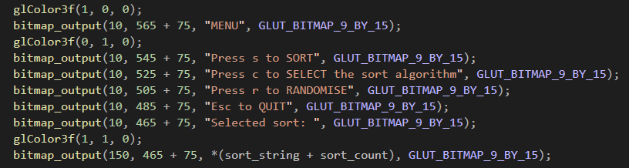
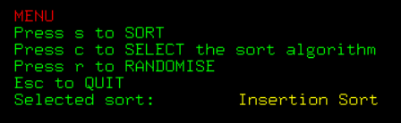
IMPLEMENTAION
MENU
Switch case that displayed menu options

Slide 8

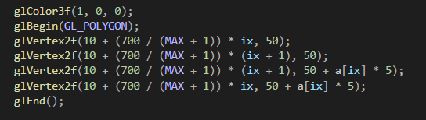
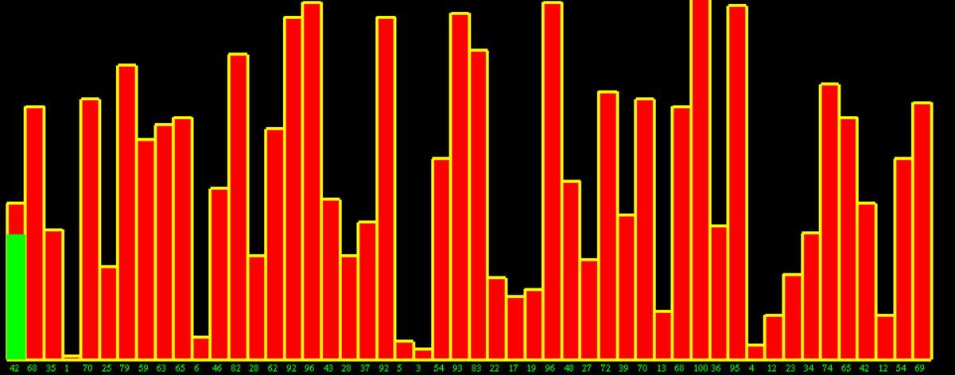
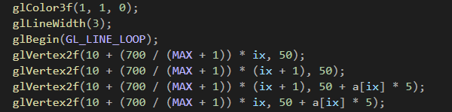
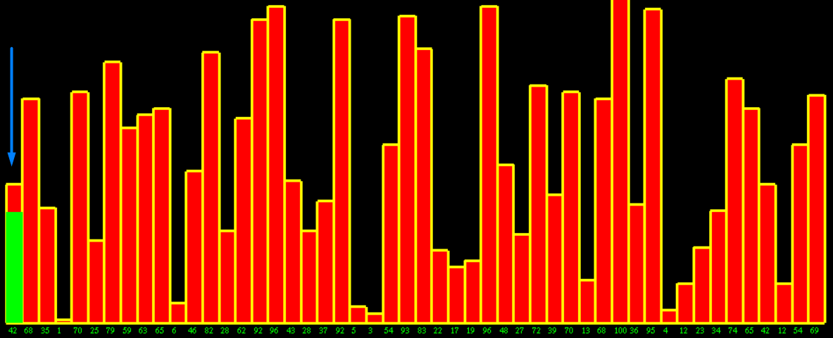
IMPLEMENTAION
Polygon OBJECT
These are the visual Polygon objects that are generated equivalent to the value being sorted
Red Bar with Yellow border
Green Highlights the current value been swapped

Slide 9
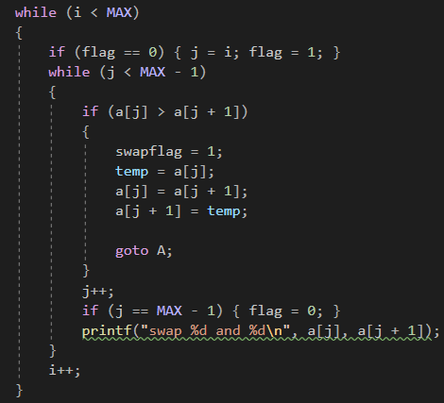
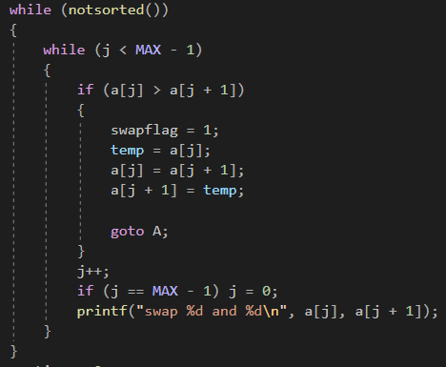
IMPLEMENTAION
Insertion Sort Algorithm
BubBle Sort Algorithm

Slide 10
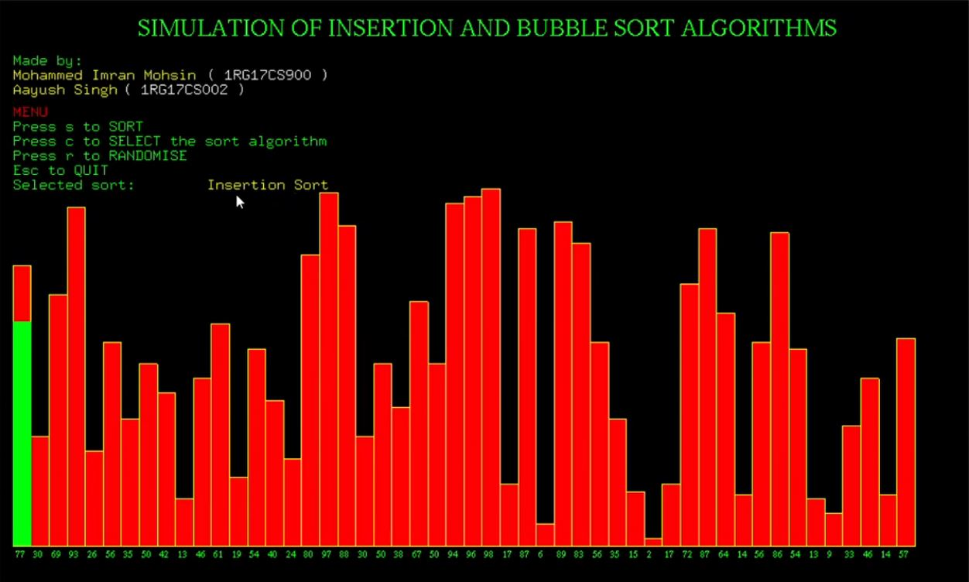
Screenshots
Screenshot 1: The generated random data set before sorting

Slide 11
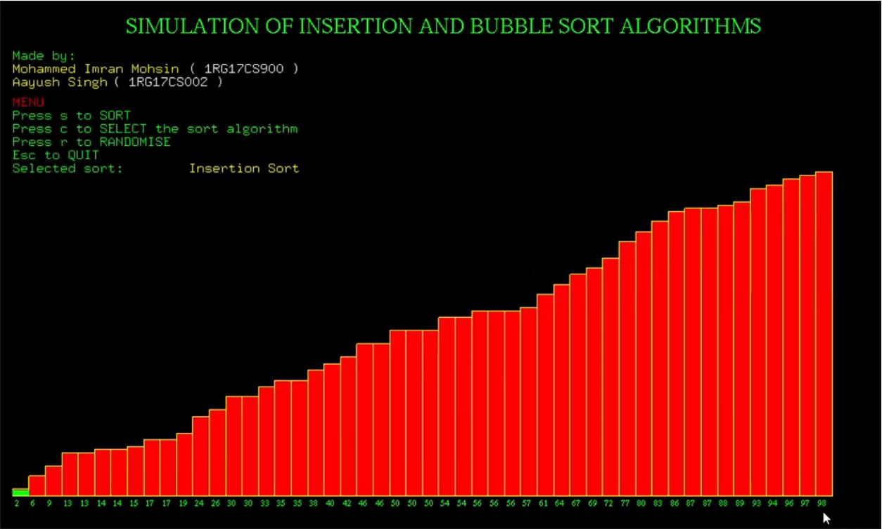
Screenshots
Screenshot 2: The generated random data set after sorting

Slide 12
Conclusion
This mini project on SIMULATION OF INSERTION AND BUBBLE SORT ALGORITHMS using OpenGL is a reliable graphics package that provides the user with the basic visual working of insertion sort and bubble sort algorithms.
It provides users with a perspective of how insertion sort and bubble sort works step by step swapping elements in an ascending order
In addition to menu option users can also pause the sorting session and switch to other sorting algorithm and continue sorting.
The user-friendly interface allows the user to interact with it very effectively.

Slide 13
FUTURE ENHANCEMENT
This project is scalable to add more different varieties of sorting algorithms such as Selection Sort, Ripple Sort and so on..
Randomly generated data set can be replaced with any data that needs sorting and can be implemented in this project.

Slide 14
References
BOOKS:
Edward Angel, “Interactive Computer Graphics”,5th edition, Pearson Education,2005
Jackie L. Neider, Mark Warhol, Tom R. Davies, ”OpenGL Red Book”, 2nd Revised Edition,2005
Donald D Hearn and M. Pauline Baker, “Computer Graphics with OpenGL”, 3rd edition.
WEBSITES:
https://www.opengl.org
https://en.wikipedia.org/wiki/OpenGL
PROJECT PREVIEW:
Video Preview ( Click here )

Slide 15
SIMULATION OF INSERTION AND BUBBLE
SORT ALGORITHMS
TEAM -14
AAYUSH SINGH ( 1RG17CS002 )
MOHAMMED IMRAN MOHSIN ( 1RG17CS900 )
THANK YOU

